Slide 1
DLM tutorial for dlmmc
Justin Alsing justin.alsing@fysik.su.se
Oskar Klein Centre, Stockholm University
Imperial Centre for Inference and Cosmology
code, install instructions and tutorials @ https://github.com/justinalsing/dlmmc
slack channels #dlm_install and #dlm_use @
https://lotus-sparc.slack.com/archives/C010U7BB6G4
citation for the dlmmc code:
Alsing, J. (2019). dlmmc: Dynamical linear model regression for atmospheric time-series analysis. Journal of Open Source Software, 4(37), 1157, https://doi.org/10.21105/joss.01157

Slide 2
Bayesian inference (conceptual intro)
DLM theory (give intuition)
DLMing with dlmmc

Slide 3
Bayesian inference (Bayes’ theorem)
some parameters we are interested in
some observations we have made
likelihood of getting our data for different values of the parameters
this is what we want; it’s called the posterior density
prior beliefs about the parameters before we made any observations
pesky normalizing constant called the evidence

Slide 4
Bayesian inference (as a process)
(1) Decide what your prior beliefs are about the parameters , write down your prior
(2) Write down your modeling assumptions, use this to derive the likelihood
(3) Use Bayes' theorem to give you the posterior (up to a normalization)…
…which you plug into an MCMC sampler to draw samples from the posterior

Slide 5
Bayesian inference (simple worked example)
I want to weight my baby. I put him on the scales 5 times and make measurements:
I’ll assume that the scales give Gaussian uncertainties with zero mean and unknown . So my unknown parameters are:
Alright let’s infer !

Slide 6
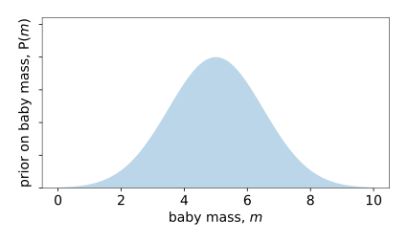
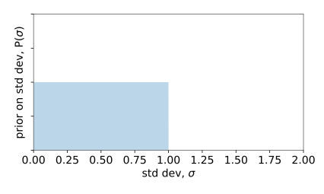
Bayesian inference (simple worked example)
(1) What are my prior beliefs on these parameters?
(2) What are my modeling assumptions and hence likelihood?
Each measurement is independent (iid) with Gaussian errors
independent
Gaussian
(3) Plug
into sampler and run…

Slide 7
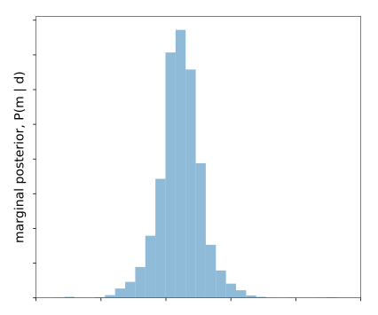
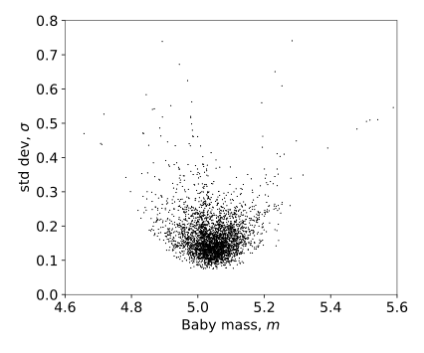
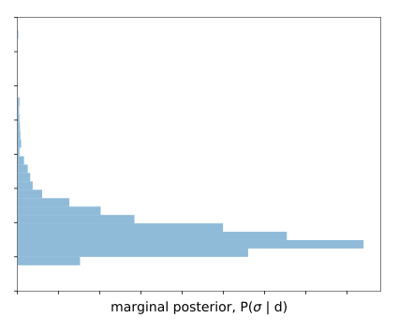
Bayesian inference (simple worked example)
Let’s have a look at the samples then…
“knowledge about the mass marginalized over all uncertainty about sigma”
“knowledge about sigma marginalized over all uncertainty about the mass”
samples

Slide 8
DLM theory (give intuition)

Slide 9
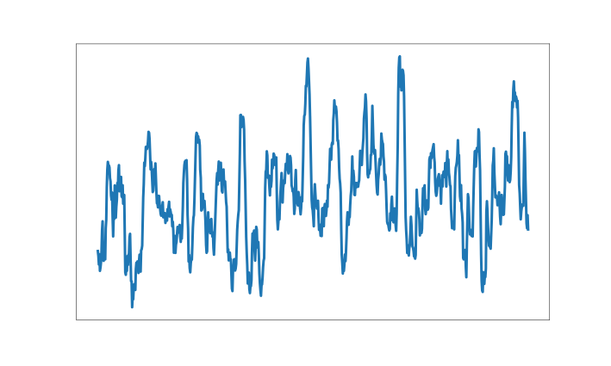
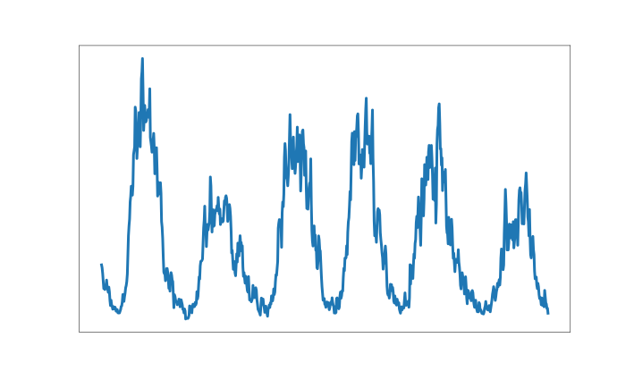
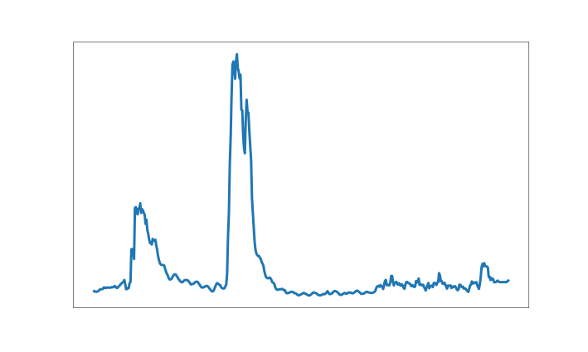
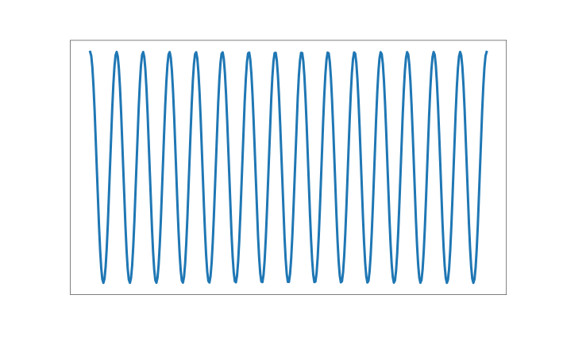
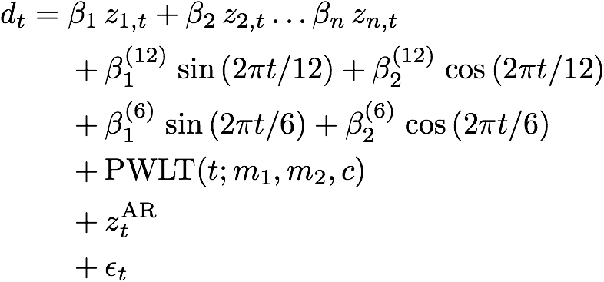
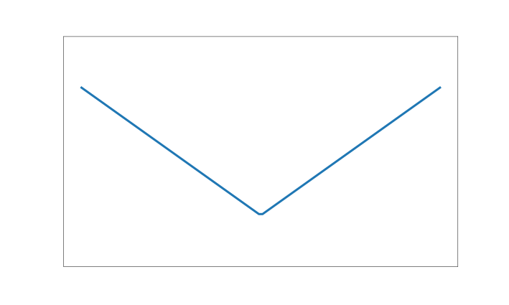
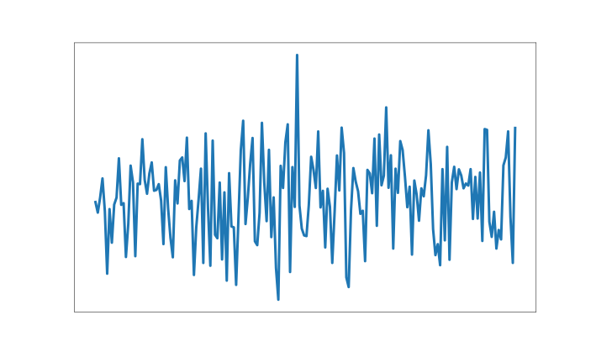
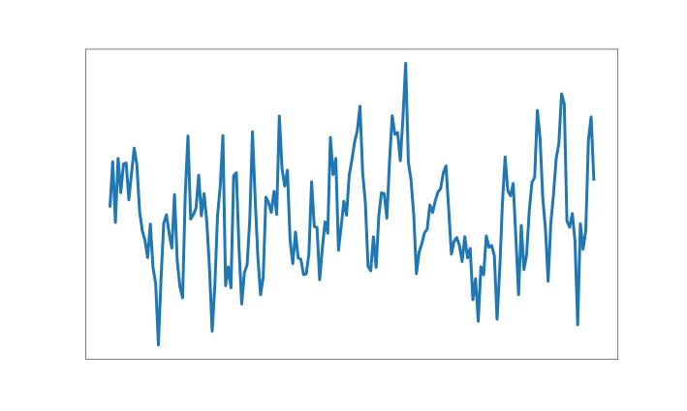
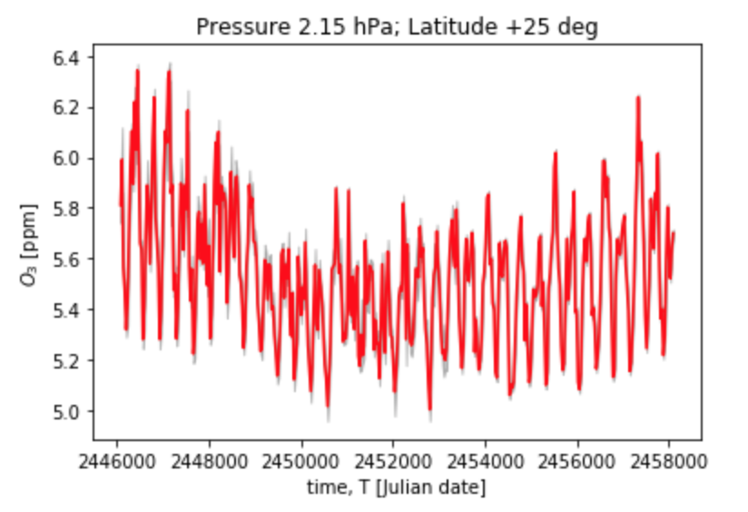
MLR
. . .
Data

Slide 10
MLR
Parameters
Careful Bayesian analysis: explore joint posterior , job done!
We usually do an approximation to this:
Make assumptions about the noise
Post hoc correction for correlated residuals
De-seasonalize first
Parameters estimated with approximate error bars
Also:
PWLT is not ideal for describing real trends
MLR is restrictive; we want a more expressive model

Slide 11
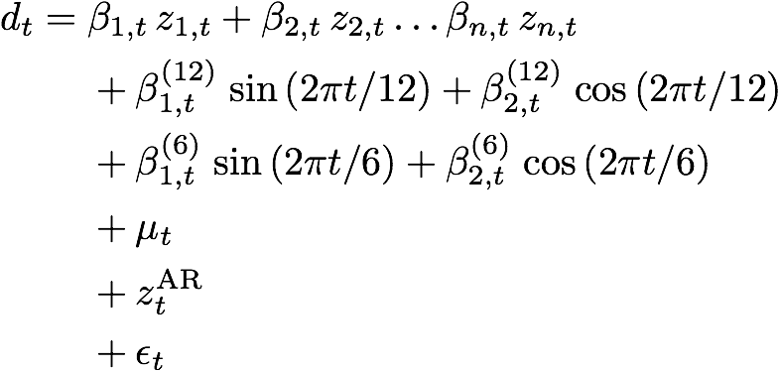
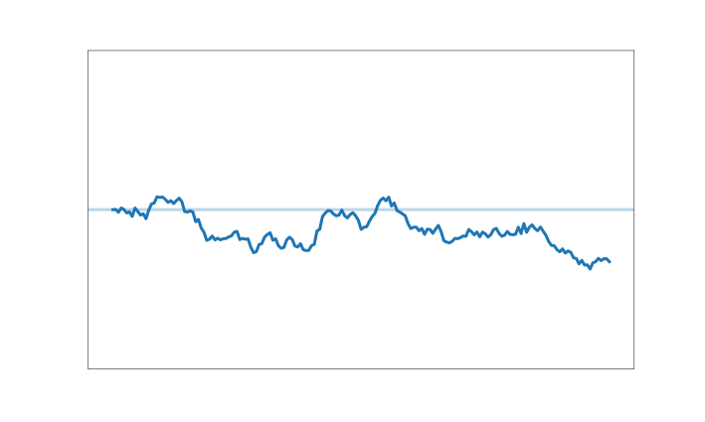
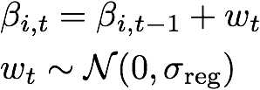
DLM model
Regression coefficients are now dynamic

Slide 12
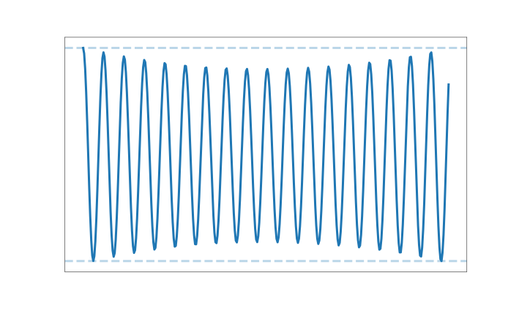
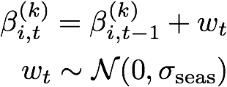
DLM model
Seasonal coefficients are now dynamic

Slide 13
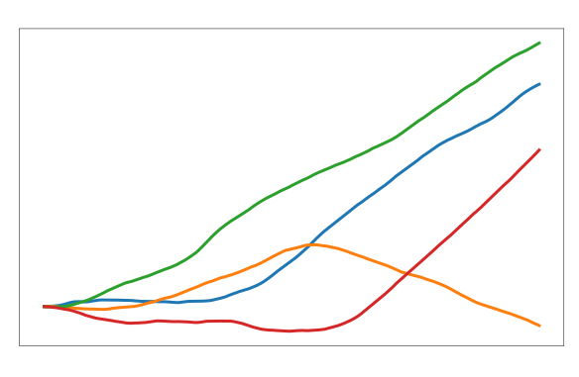
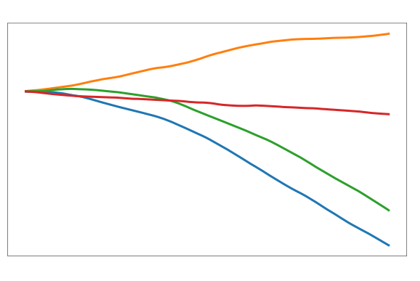
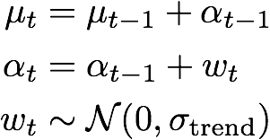
DLM model
Trend is now dynamic

Slide 14
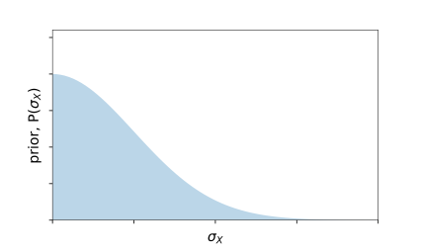
DLM priors
Hyper-parameters of the DLM model
how wiggly can the trend be?
how much can the seasonal cycle vary?
how much can the regressor amplitudes vary?
AR process parameters
uniform priors (set internally)
chosen by you!

Slide 15
DLM inference with dlmmc
We explore the joint posterior of all DLM model parameters by MCMC sampling
Once the model is specified, we make no further approximations when recovering parameters
All uncertainties, correlations, heteroskedastic noise, autoregressive terms, missing data etc are treated exactly

Slide 16
DLM inference with dlmmc
Choose a DLM model set-up (which features are on/off)
samples from the posterior of all DLM model components (trend, seasonal, regressor amplitudes etc)
Load in your regressors and your data
dlmmc
Choose your priors on the hyper-parameters (smoothness of the trend etc)

Slide 17
Now it’s time to get DLMing!
Download the code and follow the install instructions @
https://github.com/justinalsing/dlmmc
Go to your dlmmc directory (where you just downloaded the code) and open a jupyter notebook (ie., just type jupyter notebook in the terminal in that directory). For python novices who haven’t used jupyter before, see https://jupyter-notebook.readthedocs.io/en/stable/notebook.html
Open the notebook dlm_tutorial.ipynb and read it through, executing the cells (shift+enter) as you go. This will take you through everything you need to know: loading in your data and regressors, preparing them for input to the DLM, calling the DLM, and making nice plots from the outputs
Good luck and happy DLMing! If you get stuck or have any questions please please just contact me @ justin.alsing@fysik.su.se and I’ll do my best to solve your problems!
And finally, when you use the code please remember to cite the paper :)
Alsing, (2019). dlmmc: Dynamical linear model regression for atmospheric time-series analysis. Journal of Open Source Software, 4(37), 1157, https://doi.org/10.21105/joss.01157

